Slide 1
Physical Chemistry
Ying Hu
(Fifth edition)
Bilingual Program
版权所有：华东理工大学物理化学教研室

Slide 2
Part V Extension
Chapter 15
Interfacial Phenomena
Bilingual Program
版权所有：华东理工大学物理化学教研室

Slide 3
Framework of the Chapter
  15.1 Introduction
  15.2 Interfacial Tension and Interfacial Excess
  I. Thermodynamics of Interfaces
  15.3 Fundamental Equations and Equilibrium Conditions
  15.4 Laplace Equation
  15.5 Kelvin Equation
  15.6 Gibbs Isotherm
  15.7 Wetting
  II. Characteristic Properties of Interfacial Equilibria
  15.8 Vapor-Liquid Interface and Liquid-Liquid Interface
  15.9 Surfactants and Surface Films
  15.10 Adsorptions on Solid Surface
  15.11 Semi-Empirical and Theoretical Methods for Gas-Solid Adsorptions
  III. Rate Processes in Interfaces
  15.12 Dynamic Interfacial Tension
  15.13 Chemical Reactions in Surface Membranes
  15.14 Heterogeneous Catalysis
  15.15 Heterogeneous Catalytic Kinetics

Slide 4
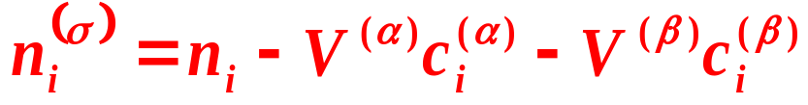
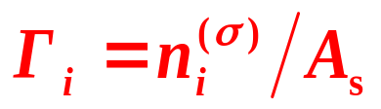
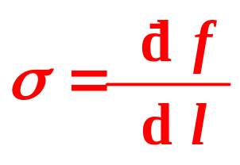
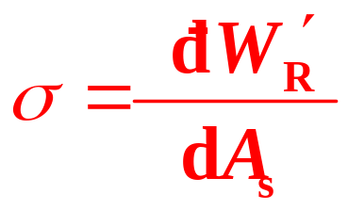
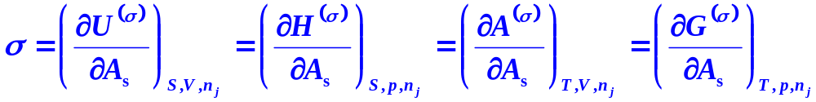
15.1 Introduction
Interfacial Phase
σ, the interfacial tension
generalized force
A_{s}, the interfacial area
generalized displacement.
n_{i}^{(σ)}, the interfacial excess
Γ_{i}^{(σ )}, the unit interfacial excess
Interfacial tension (σ or γ) is defined as
Unit: N⋅m⁻¹ or J⋅m⁻²

Slide 5
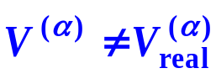
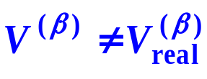
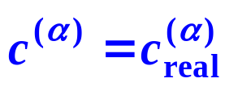
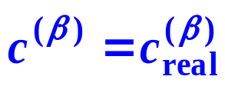
15.2 Interfacial Tension and Interfacial Excess
Gibbs Interfacial-Phase Model
Interface phase
σ
B B’
S S’
A A’
(1) V^{(σ)} = 0
(2) , V =V^{(α)}+V^{(β)}

Slide 6
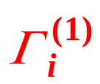
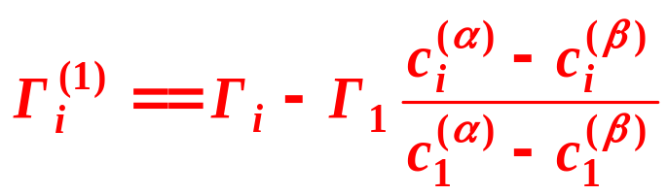
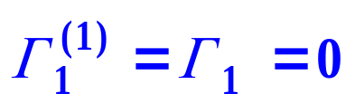
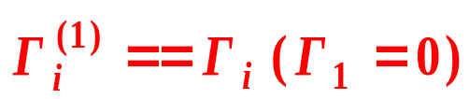
15.2 Interfacial Tension and Interfacial Excess
Gibbs Interfacial-Phase Model
(4) Gibbs Unit Interfacial Excess
The solvent 1 is adopted as a reference to define a relative unit interfacial excess for the solute i, called the Gibbs unit interfacial excess with a symbol
SS′-position independent !
Definition I
def
def
Definition II
The interfacial excess Γ_{i} when Γ₁ of the solvent equals zero.

Slide 7
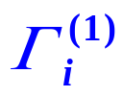
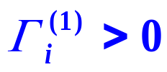
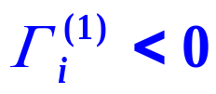
15.2 Interfacial Tension and Interfacial Excess
Unit Interfacial Adsorption
The unit interfacial excess Γ_{i} can also be called the unit interfacial adsorption, accordingly, is the Gibbs unit interfacial adsorption for solute i.
Positive adsorption
solute i is enriched in the interfacial layer
Negative adsorption
solute i is repelled in the interfacial layer

Slide 8
I.
Thermodynamics of Interfaces
Bilingual Program
版权所有：华东理工大学物理化学教研室

Slide 9
Framework of the Chapter
  I. Thermodynamics of Interfaces
  15.3 Fundamental Equations and Equilibrium Conditions
  15.4 Laplace Equation
  15.5 Kelvin Equation
  15.6 Gibbs Isotherm
  15.7 Wetting

Slide 10
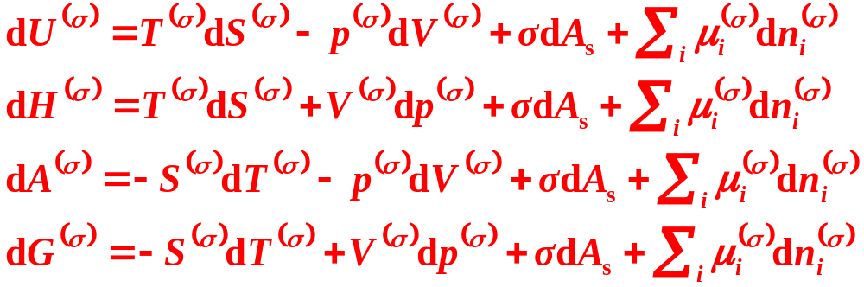

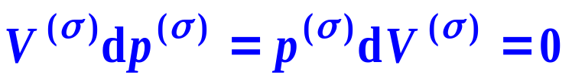
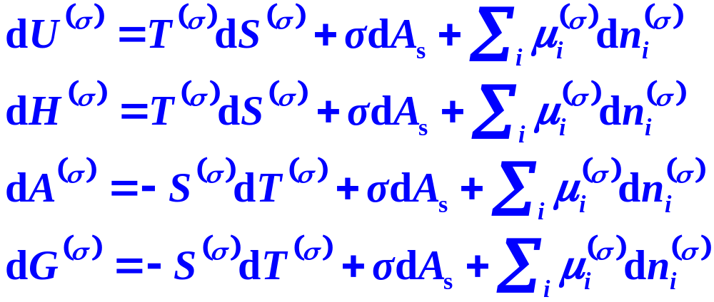
Fundamental Equations for Interfacial Phase
Fundamental Equations for Gibbs Interfacial Model

Slide 11
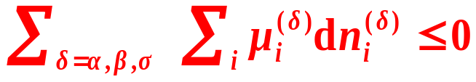



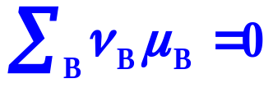
2. Equilibrium Criterion and Equilibrium Conditions when Interfacial Phases Exist
Equilibrium Criterion
Thermal Equilibrium
Mechanical Equilibrium
Phase Equilibrium
Chemical Equilibrium

Slide 12
Example
1kg of water is dispersed to droplets with a radius of 10⁻⁸ m at 25℃. Estimate the minimum work needed.
Solution: Density of water ρ =1.00×10³kg⋅m⁻³, surface tension σ = 0.0720 N⋅m⁻¹,
Note：Since the isobaric specific heat capacity of water is 4.179kJ⋅K^{−1⋅kg−1}, the work is corresponding to a temperature rise of 5.17K.

Slide 13
Framework of the Chapter
  I. Thermodynamics of Interfaces
  15.3 Fundamental Equations and Equilibrium Conditions
  15.4 Laplace Equation
  15.5 Kelvin Equation
  15.6 Gibbs Isotherm
  15.7 Wetting

Slide 14
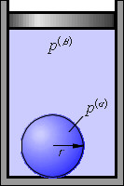


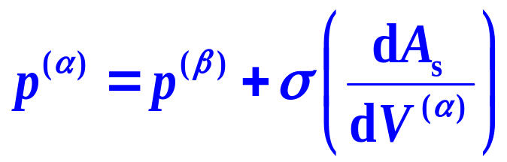

Mechanical-Equilibrium For Curved Interfaces
Gibbs Model
mechanical-equilibrium condition

Slide 15










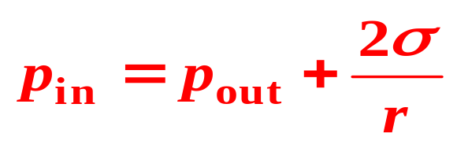

Slide 16
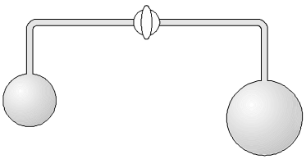
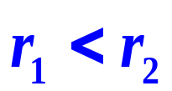
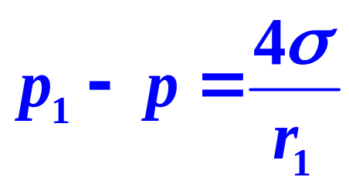
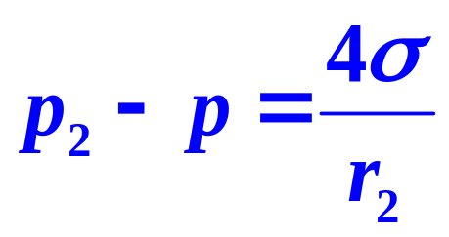
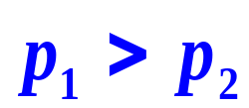

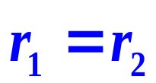
There are two soap bubbles with different radius at ends of the glass tube. If opening the cock , how the size of the two bubbles will change. What is the final state?
1
2
The final state is that
Notes:
需要从本质上面去讨论：压力大，曲率半径并非单调递减

Slide 17
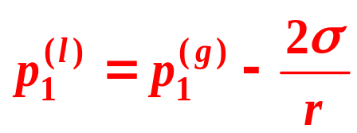
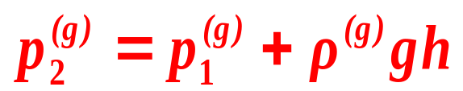
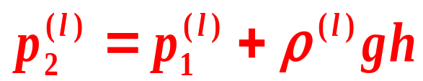
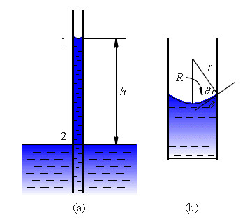
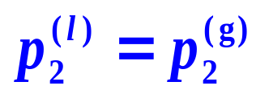
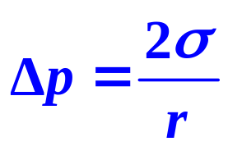
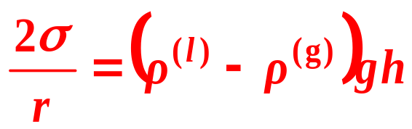
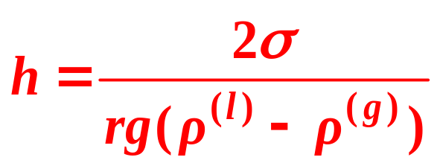
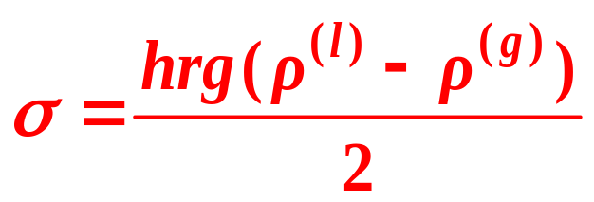
Capillary Rise or Depression

Slide 18


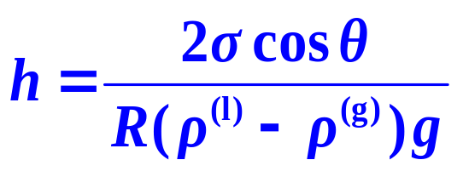
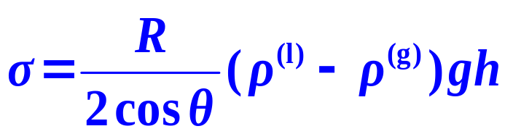
The contact angle

Slide 19
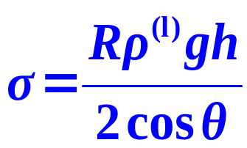
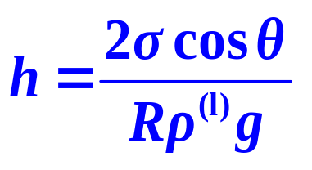
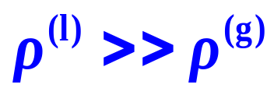
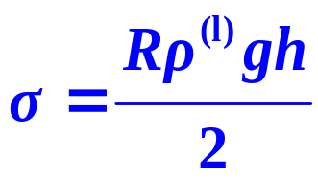
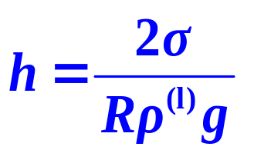

Capillary Rise or Depression
when

Slide 20
Identify which of the followings is(are) correct
?
?
a
b
c
d

Slide 21
Framework of the Chapter
  I. Thermodynamics of Interfaces
  15.3 Fundamental Equations and Equilibrium Conditions
  15.4 Laplace Equation
  15.5 Kelvin Equation
  15.6 Gibbs Isotherm
  15.7 Wetting

Slide 22



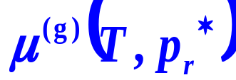


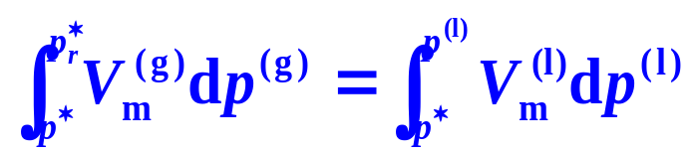


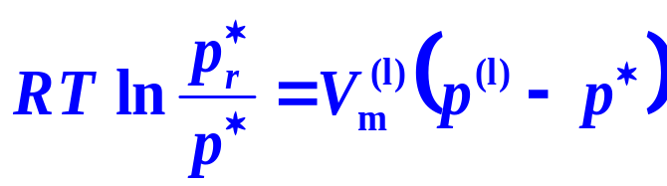
1. Variation of Vapor Pressure with Liquid Pressure
=
=
Notes:
此处化学势对应纯态的化学势表达

Slide 23
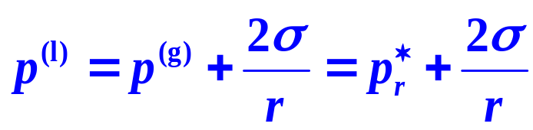




2. Vapor Pressure of Liquid with Curved Surface, Kelvin Equation
(1) Vapor Pressure of Liquid Droplet or Liquid in Capillary with Convex Meniscus
(2) Vapor Pressure in Capillary with Concave Meniscus
Kelvin Equation

Slide 24
(1) Vapor Pressure of Liquid Droplet or Liquid in Capillary with Convex Meniscus
(1) Vapor Pressure of Liquid Droplet or Liquid in Capillary with Convex Meniscus
It is higher than that of a planar liquid.
The vapor pressure of liquid droplet or liquid in capillary with convex meniscus increases as the radius of the liquid droplet decreases.
(2) Vapor Pressure in Capillary with Concave Meniscus
(2) Vapor Pressure in Capillary with Concave Meniscus
It is lower than that of a planar liquid.
The smaller the radius of the concave meniscus, the lower the vapor pressure is.

Slide 25







(3) Applicable Limits of the Kelvin Equation
The of water droplet at 25℃
(4) Cavity in Liquid
(5) Melting Point of Tiny Crystal
Kelvin Equation can also be used to estimate the vapor pressure of tiny crystals

Slide 26



3. Meta-stable State
(1) Supersaturated Vapor
Metastable
When the vapor condenses, the new phase just with emerging is tiny liquid droplets radius r, the corresponding vapor pressure is
Increase the pressure p_{e} isothermally beyond , the condensation can then appear. This vapor with a pressure exceeding p* is called a
supersaturated vapor.
The chemical potential is greater than that of the planar liquid.

Slide 27









(2) Superheated Liquid
When boil starts, the gas phase just formed is tiny cavities.
To prevent bumping, some zeolites, bisque are added to provide small cavities serving as cores of gasification. The other choice is lowering the pressure, and then some cavities may appear in the interior of the superheated liquid.
Metastable

Slide 28



Example
How much the temperature will raise, that can have the same effect as the vapor pressure increase for a droplet? The water droplet has a radius of 10⁻⁸ m, the density is 0.998 ×10³ kg/m⁻³, the molar enthalpy of vaporization is 44.01kJ/mol⁻¹ at 25 ℃.
Solution：
According to the Kelvin equation
From the Claperon-Clausius equayion

Slide 29
  I. Thermodynamics of Interfaces
  15.3 Fundamental Equations and Equilibrium Conditions
  15.4 Laplace Equation
  15.5 Kelvin Equation
  15.6 Gibbs Isotherm
  15.7 Wetting

Slide 30






1. Gibbs Isotherm
Derivation (V^{(σ)} = 0 )
Isothermally
—Gibbs Isotherm

Slide 31








1. Gibbs Isotherm
For binaries
Adopt Concentration
For dilute solutions,

Slide 32




Example
In the range of dilute solutions, generally, the linear relation
σ =-bc₂ exists between the gas-liquid surface tension and the bulk concentration. Derive the relation between the unit interfacial adsorption and the concentration.
Solution:
It shows that in the range of dilute solution,

Slide 33




2. Positive Adsorption and Negative Adsorption
Type A: Negative adsorption inorganic substances such as NaCl, Na₂SO₄, KOH, NH₄Cl, KNO₃.
σ
A
Type B: Positive adsorption organic substances such as alcohol, aldehyde, ketones, carboxylic acid, ester.
B
Type C: Positive adsorption a large adsorption at low concentration, surfactants
C
c₂

Slide 34


for aqueous solutions of butyric acid and NaCl. aqueous solutions of butyric acid and NaCl.
Surface tension
Adsorption isotherms

Slide 35
  I. Thermodynamics of Interfaces
  15.3 Fundamental Equations and Equilibrium Conditions
  15.4 Laplace Equation
  15.5 Kelvin Equation
  15.6 Gibbs Isotherm
  15.7 Wetting

Slide 36

Various kinds of wetting and spreading
spreading wetting
adhesive wetting
non-wetting
spreading
non-spreading
dip wetting

Slide 37



1. Spreading Coefficient
Definition
The spreading process of a liquid drop on a solid
Spreading coefficient ϕ
Liquid I
Liquid II

Slide 38





Physical Meaning of the Spreading Coefficient
Adhesive work
Cohesive work
L
L
Pull apart
Pull apart
L
Adhesion
Adhesion
S
When Wa > Wc, ϕ is positive, ΔG is correspondingly negative, spreading can then happen.

Slide 39



2. The Contact Angle and Young's Equation
Contact Angle
When ϕ is negative, ΔG is positive, spreading could not happen,
the adhesive wetting or the non-wetting.
θ
Contact angle is defined by the angle between vectors σ _{g,l} and σ_{l,s}.

Slide 40









Young's Equation
Capillary
adhesive wetting
non-wetting
adhesive wetting or
non-wetting?

Slide 41




Calculating Spreading Coefficient

